Slide 1
Propositional Logic

Slide 2
Proposition
A proposition is a statement that is either true or false, but not both.
1.Lucknow is the capital of U.P.
2. 2-1 = 1 3. x+1 = 4
4. What is the time now?
Here 1 & 2 are propositions but 3 & 4 are not propositions, since these are not declarative.

Slide 3
Propositional Variables:
( Or Statement Variables)
We usually denote a proposition by a letter: p, q, r, s, …
The truth values of a proposition is true, denoted by T, if it is a true proposition and if it is false, denoted by F.
Propositional calculus or propositional logic is the area that deals with propositions. It is first developed systematically by the Greek philosopher Aristotle more than 2300 years ago (384 BCE-322 BCE).
Compound Proposition: which are formed from existing propositions using logical operators.

Slide 4
Connectives: The logical operators that are used to form new propositions from two or more existing propositions.

Slide 5
Definition . Negation of p
Let p be a proposition. The statement “It is not the case that p” is also a proposition, called the “negation of p” or ¬p (read “not p”)
Table .
The Truth Table for the
Negation of a Proposition
p ¬p
p = The sky is blue.
¬p = It is not the case that the sky is blue.
¬p = The sky is not blue.
T F
F T

Slide 6
Definition . Conjunction of p and q
Let p and q be propositions. The proposition “p and q,” denoted by p∧q is true when both p and q are true and is false otherwise. This is called the conjunction of p and q.
Table . The Truth Table for the Conjunction of two propositions
p q p∧q
T T T
T F F
F T F
F F F

Slide 7
Example:
p = It is raining today.
q= Today is Monday.
p∧q = Today is rainy Monday.

Slide 8
Definition . Disjunction of p and q
Let p and q be propositions. The proposition “p or q,” denoted by p∨q, is the proposition that is false when p and q are both false and true otherwise.
Table. The Truth Table for the Disjunction of two propositions
p q p∨q
T T T
T F T
F T T
F F F

Slide 9
Example:
p = Students taken real analysis can attend this class.
q= Students taken linear algebra can attend this class.
p∨q = Students who have taken real analysis or linear algebra can attend this class.

Slide 10
Definition . Exclusive or of p and q
Let p and q be propositions. The exclusive or of p and q, denoted by p⊕q, is the proposition that is true when exactly one of p and q is true and is false otherwise.
Table . The Truth Table for the Exclusive OR of two propositions
p q p⊕q
T T F
T F T
F T T
F F F

Slide 11
Definition . Implication p→q
Let p and q be propositions. The implication p→q is the proposition that is false when p is true and q is false, and true otherwise. In this implication p is called the hypothesis (or antecedent or premise) and q is called the conclusion (or consequence).
Table. The Truth Table for the Implication of p→q.
p q p→q
T T T
T F F
F T T
F F T

Slide 12
Implications
If p, then q
p implies q
if p,q
p only if q
p is sufficient for q
q if p
q whenever p
q is necessary for p
P only if q says that p cannot be true when q is not true.
q unless ¬p

Slide 13
Example 1:What is the value of the variable x after the statement
if 2 +2 = 4 then x: = x +1.
Because 2 +2 = 4 is true, the assignment statement x: = x +1 executed. Hence x has the value 0 + 1 = 1.

Slide 14
Example 2: If I am elected, then I will lower the taxes.
Example 3: Sheela will find a good job, when she learns DMS.
Or
For Sheela to get a good job, it is sufficient for her to learn DMS.
.

Slide 15
Related Implications
Converse of p → q is q → p
Inverse of
p → q
is
¬ p → ¬ q
Contrapositive of p → q is the proposition ¬q → ¬p

Slide 16
Example 1: Every convergent sequence is bounded.
Or
Sequence is convergent → It is bounded
is equivalent to
Sequence is not bounded → Sequence is not convergent .

Slide 17
Example 2: If Lim f(x) as x → a exists implies Limit is unique
is equivalent to
Let if possible Lim f(x) as x → a are different → Lim f(x) as x → a, does not exist.
Example 3: The home team wins whenever it is raining
Or
If it is raining, then home team wins.
Its contrapositive is, If the home team does not wins, then it is not raining.

Slide 18
Definition: Biconditional
Let p and q be propositions. The biconditional p↔q is the proposition that is true when p and q have the same truth values and is false otherwise. “p if and only if q, p is necessary and sufficient for q”
p | q | p↔q
T | T | T
T | F | F
F | T | F
F | F | T

Slide 19

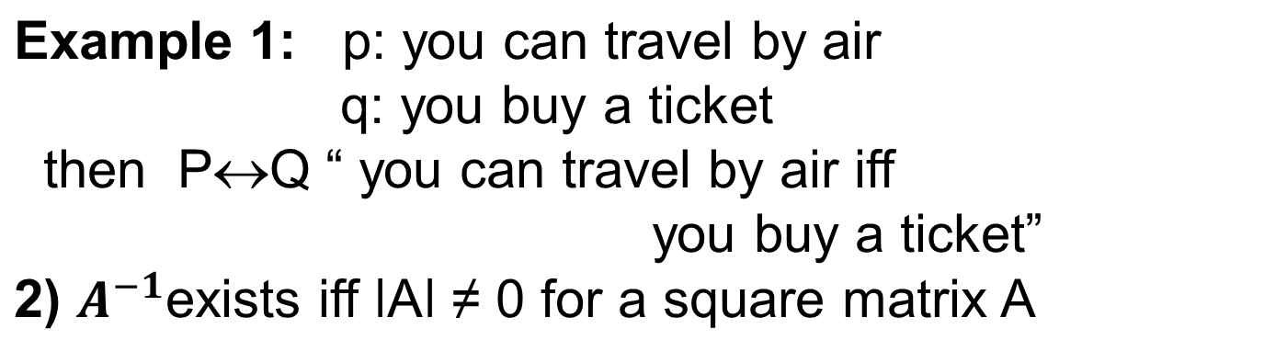
Remark:
P↔Q is true when both the conditional statement p → q and q → p are true and is false otherwise.
.
Other ways: “ p is necessary and sufficient for q”
“ if p then q and conversely”
“ p iff q”

Slide 20
Example: Construct the truth table of (p∨¬q) → (p∧q)
p | q | ¬q | p∨¬q | p∧q | (p∨¬q) → (p∧q)
T | T | F | T | T | T
T | F | T | T | F | F
F | T | F | F | F | T
F | F | T | T | F | F

Slide 21
Precedence of logical operators:
Operator | Precedence
Negation ¬ | 1
Conjuction ∧ | 2
Disjunction ∨ | 3
Conditional → | 4
Biconditional ↔ | 5
¬p ∧ q means (¬p ) ∧ q does not mean ¬(p ∧ q)
p ∧ q ∨ r means (p ∧ q) ∨ r

Slide 22
Q1: How can this sentence be translated into a logical expression ?
“you can access the internet from campus only if you are a computer science major or are not a freshman
Solution: Treat
p: you can access the internet from campus
q: You are a computer science major
r: You are a freshman
Then we can translate above sentence into a logical expression as p→ (q ∨ ¬ r)

Slide 23
Q2: Translate into a logical expression ?
“ you can’t ride the roller coaster if you are under 4 feet tall unless you are older than 16 year old”
Let us denote
p: you can ride the roller coaster
q: you are under 4 feet tall
r: you are older than 16 year old
Then we can translate above sentence into a logical expression as
(q ∧¬r) →¬p

Slide 24
Proposional Equivalences
An important technique in proofs is to replace a statement with another statement that is “logically equivalent.”
Tautology: compound proposition that is always true, regardless of the truth values of the propositions that occur in it.
Example: p ∨ ¬ p

Slide 25
Contradiction : A Compound proposition which is always false regardless of the truth values of the propositions in it.
Example: p ∧ ¬ p
Contingency : A compound proposition which is neither Tautology nor Contradiction.

Slide 26

Logically Equivalence
Compound propositions that have same truth values in all possible cases, are called logically equivalent.
OR P and Q are logically equivalent if P↔Q is a tautology.
This is denoted: by P Q
Example: p ∨ (q ∧ r) ≡ (p ∨ q) ∧ (p ∨ r)

Slide 27
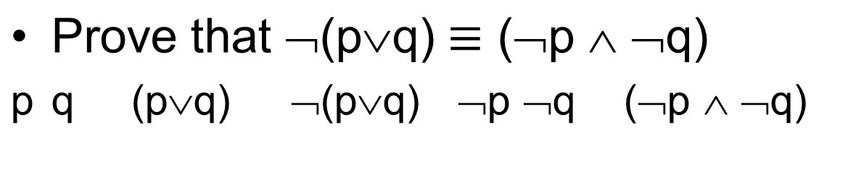
Example: De Morgan’s Law
T T
T F
F T
F F
T F F F F
T F F T F
T F T F F
F T T T T

Slide 28
Example: Distribution Law
p q r q∧r p∨(q∧r) p∨q p∨r (p∨q)∧(p∨r)
T T T T T T T T
T T F F T T T T
T F T F T T T T
T F F F T T T T
F T T T T T T T
F T F F F T F F
F F T F F F T F
F F F F F F F F

Slide 29
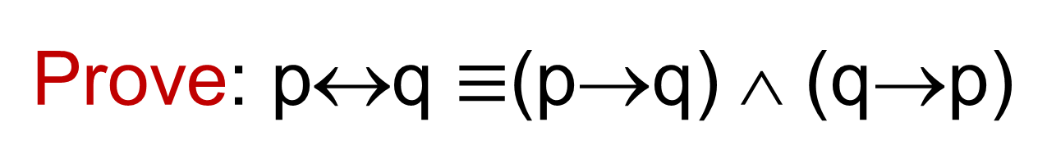
p q p↔q p→q q→p (p→q)∧(q→p)
T T T T T T
T F F F T F
F T F T F F
F F T T T T
We call this biconditional equivalence.

Slide 30
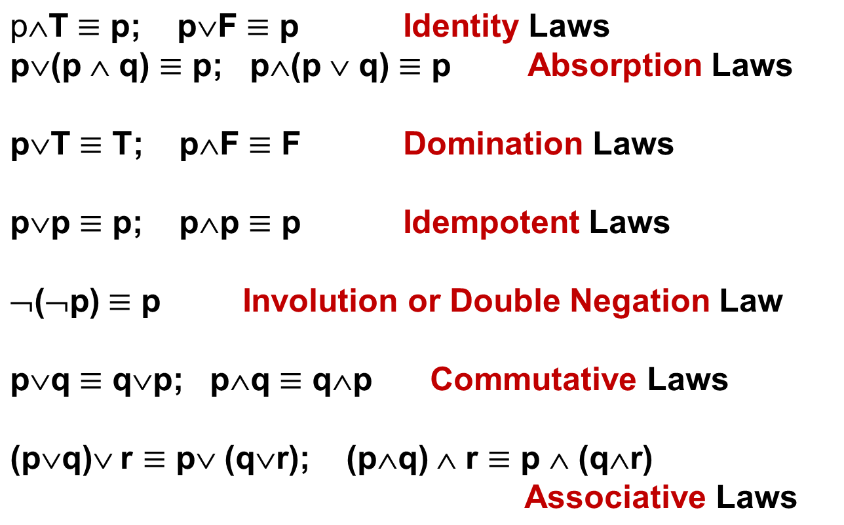
List of Logical Equivalences

Slide 31
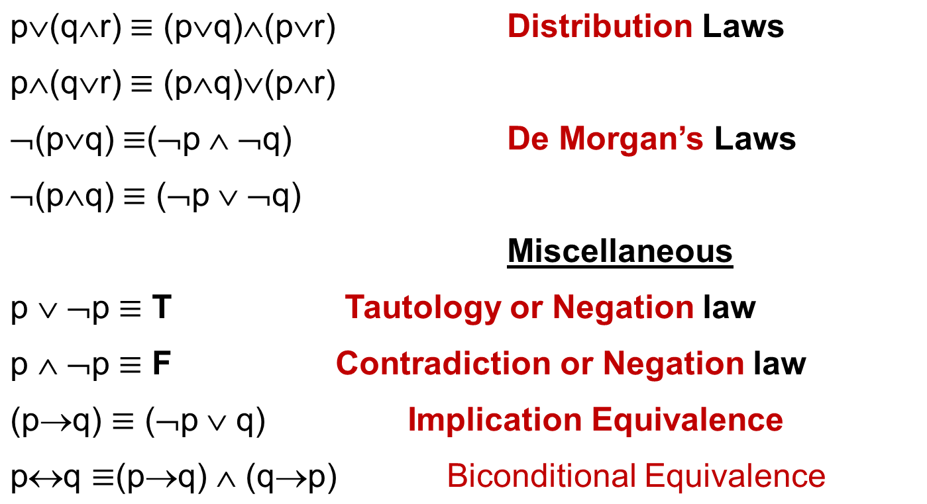
List of Equivalences

Slide 32
Problem 1: using the properties of above equivalance table prove that:
¬(p∨(¬(p∧q)) and (¬p ∧ ¬q) are logically equivalent.
Important result: Show that p→q and ¬p∨ q are logically equivalent by using truth table
(this property can be used for proving some results).
Problem2 : Show that (p∧q)→(p∨q) is a tautology.

Slide 33
Dual of a compound proposition
Dual of a compound proposition that contains only logical operators ∨, ∧ and ¬ is the compound proposition obtained by replacing
each ∨ by ∧,
each ∧ by ∨,
each T by F and
each F by T.
The dual of S is denoted by S*

Slide 34
Predicates and Quantifiers:
Predicate: consider statement involving variable, such as “x>3” or x is greater than 3
variable predicate → refers to a property that the subject the statement can have.
Propositional function: let P(x): x>3
P(4) has truth value T
P(3) has truth value F .
Example: let Q(x,y) denote the statement “x=y+3”
what are the truth values of the proposition
Q(1,2) & Q(3,0).

Slide 35
Definition: A statement of the form P(x₁ , x₂ …,x_{n} ) is the value of the propositional function P at n- tuple (x₁ , x₂ …,x_{n} ) and P is also called n-place predicate or a n-ary predicate.
Example: consider the statement
if x>0 then x:=x+1
if P(x) is true program executes i.e.
x:=x+1 is executed and
the variable x is increased by 1
if P(x) is false the assignment statement
x:=x+1 is not executed. So, the
value of x remain unchanged.

Slide 36
Preconditions & Post conditions:
Predicates are used in the verification of computer program always produce desired output when a valid input is given . The statements that describe valid input are know as preconditions and the conditions that the output should satisfy when the program has run are known as post conditions.
Example: temp:=x precondition
x:=y
y:=temp post condition

Slide 37
Quantifiers : Quantification is another way to create a
proposition from a propositional function.
Quantification expresses the extent to
which a predicate is true over a range of
elements.
In English, the words all, some, more and few are used in quantification.
Universal quantifier: tells us that a predicate is true for every element under consideration.
“for all” “for every” “for arbitrary”
“for each” “for any”
{P(x)∀ xϵ S} where S → Domain of discourse
If some xϵS s.t. p(x) is false, x is called counter example

Slide 38
Existential quantification:
Tells us one or more element under consideration for which predicate is true.
Predicate calculus: The field of logic that deals with predicates and quantifiers is called the predicate calculus.
Quantifiers:
statement | When true | When false
∀x P(x) | P(x) is true for every x | There is an x for which P(x) is false
∃ x P(x) | There is an x for which P(x) is true | P(x) is false for every x

Slide 39
Example 1: Let Q(x) be the statement “x<2” . What is the truth value of quantification
∀ x Q(x), where domain is R? Ans: F
Example 2: What is true value of ∀ x P(x) , where P(x) is the statement “x² < 10” and the domain consists of positive integers not exceeding 4? Ans: F
Example 3: What is the truth value of ∀x (x²≥ x) if the domain consists of all real numbers? Give your conclusion if the domain of discourse consists of all integer?

Slide 40
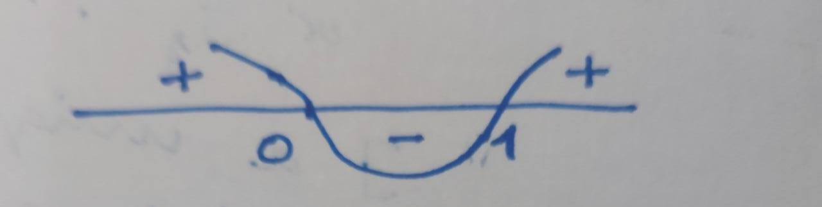
Solution3: x² ≥ x ⟹ x(x-1) ≥ 0
since the expression in L.H.S. ≥ 0 iff x ≥ 1 or x< 0 and xϵ R
∀x (x² ≥ x ) is not true for all x ϵ R
therefore, It’s truth value is false.
In case, x ϵ ℤ(set of integers) ∀ x (x² ≥ x) is true.

Slide 41
The existential quantifier:
The existential quantification of P(x) is the proposition
“∃ an element x in the domain s.t. P(x)”
We use the notation ∃ x P(x), in which ∃ is called existential quantifier.
“There exists”
“for some”
“for at least one”
“there is”
are similar.

Slide 42
Example: Let P(X) be denotes the statement “x > 3”. What is the truth value of the quantification ∃ x P(x),
where the domain consists of all real number ?
Solution: ∃ x = 4 for which “x > 3” is true.
∃ x p(x) is true.
Remark: If all elements in the domain can be listed say
x₁, x₂, x₃, …, x_{n} the existential quantification
∃ x p(x) is same as disjunction.
P(x₁) ∨ P(x₂) ∨ P(x₃) … ∨ P(x_{n})
Precedence of quantifiers: The quantifiers ∀ and ∃ have higher precedence than all logical operators from propositional calculus. ∀ x P(x) ⋀ Q(x) means
(∀ x P(x) ) ⋀ Q(x)

Slide 43
Binding and Free Variables:
When a quantifier is used with a variable x, its occurrence is called bound, while occurrence of a variable is not bounded by a quantifier, is called free.
For example: ∃ x (x + y = 1), x is bound by the existential quantifier so x is bound, but y is not restricted, so y is free.

Slide 44
Logically equivalences involving quantifiers: Statements involving predicates and quantifiers are logically equivalent if and only if they have the same truth value no matter which predicates are substituted into these statements and which domain of discourse is used for the variables in these propositions.
We use the notation S≡T to indicate the two statements S and T involving predicates and quantifiers are logically equivalent.
Example: ∀ x (p(x) ∧ q (x)) ≡ ∀ x p(x) ∧ ∀ x q (x)
a Universal quantifier distributes over conjunction
an existential quantifier distributes over disjunction
Universal quantifier can’t distributes over disjunction
An existential quantifier can’t distributes over conjunction

Slide 45
Negating quantified Expressions
(Demorgan’s Laws for quantifiers)
¬∀ x p(x) ≡ ∃ x ¬ p(x) Negation of Univ. Quanti.
¬ ∃ x p(x) ≡ ∀ x ¬ p(x) Negation of Exist. Quanti.
Example: ∃ x p(x) : It is raining at a place x in Jaunpur
¬ ∃ x p(x) : It is not the case that It is raining at a place x in Jaunpur
Or nowhere is raining in Jaunpur
Or It is not raining at each place in Jaunpur
i.e. ∀ x ¬ p(x)

Slide 46
DE Morgan's Laws for Quantifiers
Example: Write negation of “there is an honest politician” and “all Americans eat Cheese Burgers”
Solution: “all politicians are not honest”
“There is an American who does not eat Cheese Burgers”
Negation | Equivalent | When is negation True | When False
¬ ∃ x p(x) | ∀ x ¬p(x) | For every x, p(x) is false | There is an x for which p(x) is true.
¬ ∀ x p(x) | ∃ x ¬p(x) | There is an x, for which p(x) is false | p(x) is true for every x

Slide 47
Example 1: What are the negations of the statements
∀x (x² > x) and
∃ x (x² =2),
if the domain consists of all real numbers?
Example 2: Show that
¬∀ x (p(x)→ q(x) ) ≡ ∃ x (p(x) ∧ ¬ q(x) )
Sol:
¬∀ x (p(x)→ q(x) ) ≡ ∃ x ¬ (p(x)→ q(x) )
≡ ∃ x ¬ (¬ p(x)∨ q(x))
≡ ∃ x ( p(x)∧ ¬ q(x))

Slide 48
Rules of inference :
Here are some examples of sound rules of inference
  A rule is sound if its conclusion is true whenever the premise is true
Each can be shown to be sound using a truth table
  RULE PREMISE CONCLUSION
  Modus Ponens A, A → B B
  And Introduction A, B A ∧ B
  And Elimination A ∧ B A
  Double Negation ¬¬A A
  Unit Resolution A ∨ B, ¬B A
  Resolution A ∨ B, ¬B ∨ C A ∨ C

